Slide 1
Announcements
Schedule:
  Tu 2/25: Discuss Thernstrom Reading + Start Treatments
  Th 2/27: Finish Treatments + Review for Exam 1 (if time)
  Tu 3/3: Exam 1 → Covers Ch 5, 6, 10, + Thernstrom & Lecture
I am working on feedback for Survivor Questions… Should be done by tomorrow
In case you’re scared you’re leaving something important out, here’s my list of topics to consider:
In addition to asking about the person's experience and coping strategies, I'd suggest asking about some of the specific topics from class, such as immediate responses to stress (fight, flight, fright, tend and befriend, whether they felt the experience made them more likely to get sick in the aftermath, coping strategies, access to social support and its value, personality (optimism, hostility, conscientiousness, etc.), resources, and whether anything good came out of the experience or they have advice for others (post traumatic growth).

Slide 2
* Stress & Coping Exam *
Exam 1 is Tuesday 3/3!
  Covers Ch 5, 6, 10, + Thernstrom & Lecture
  4 short answer questions worth 10 pts each
  30 MC questions worth 2 pts each
  ~3 potential bonus points
Advice:
  In the textbook, focus on key terms in boldface or italics
  For key terms in lecture and/or the textbook, ask:
    Can you define this term? Can you give an example? Can you recognize an example?
  You need to know “big names” from lecture, but NO DATES
    Big names from theories = Cannon, Taylor, Selye, Lazarus & Folkman…
    Big names from major studies = Sheldon Cohen, Janice Kiecolt-Glazer…any study that has an entire slide devoted to it – can you recognize why it was done and what was found?
Email me with questions or to schedule a meeting
Example questions on the next few slides…

Slide 3
These are the types of questions you will see on the exam after the multiple choice questions. Each one can be answered with several sentences or bullet points. You will select 4 out of 7 questions to answer. The questions on this page are examples.
What are 3 major types of social support? Name and briefly define each one. Which is the most beneficial for health and well-being?
What is hostility? Explain 3 specific pathways through which hostility could undermine health.
Describe the General Adaptation Syndrome, and give two critiques of this model.
What is the gate control theory of pain? What are two factors associated with opening the gates, and two that are associated with closing the gates?

Slide 4
Example MC Questions
________ - focused coping is most effective when there is _____ that can be done to change a negative situation.
A. Problem; little
B. Emotion; nothing
C. Emotion; something
D. Problem; nothing
2. All of the following characterize Type A behavior EXCEPT…
A. strong competitive drive
B. high levels of time urgency
C. experience anger and hostility
D. high intelligence
3. Which of the following is NOT a valid criticism of Holmes and Rahe's (1967) Stressful Life Events (SLE) inventory (also known as the SRRS) that we discussed in class?
A. It focuses on recent experiences, even though some stressors have long-lasting consequences.
B. It fails to consider individual differences in the experience of stressful events.
C. There is no evidence supporting a link between this measure and actual health outcomes.
D. It restricts the range of possible stressors to those on the list.
E. All of the above.
4. Using terminology from class, what kind of stressor is experiencing a home burglary in which irreplaceable items are stolen?
A. A cataclysmic event
B. A major life hassle
C. A stressful life event
D. A daily hassle

Slide 5
5. One therapeutic technique is called _________, in which patients focus on a relaxing scene to calm down or distract from other stressors or pain.
A. mindfulness meditation
B. guided imagery
C. exposure therapy
D. progressive muscle relaxation
E. cognitive reframing
6. Which of the following statements about nerve fibers is TRUE?
A. A-delta fibers are unmyelinated fibers.
B. A-delta fibers transmit information much quicker than C-fibers.
C. C-fibers are small and myelinated, and therefore can carry information very rapidly.
D. Neither A-delta fibers or C-fibers carry information in the reception of pain
E. Both A and C are true
7. How did Janice Kiecolt-Glaser and her colleagues study the effects of conflict on immune functioning using highly controlled methods?
They gave families the opportunity to move to a different neighborhood to study the effects of moving from a high-conflict area to a lower stress environment.
They taught people to either use problem-focused or emotion-focused coping techniques to prevent conflict
They gave spouses blisters and monitored how much they healed over two weeks.
They interviewed people to learn about conflict in their lives, then deliberately infected people with a cold virus, quarantined them, and measured their symptoms.
None of the above are correct

Slide 6
8. Which of the following statements about gender and social support is FALSE?
A. Women are more likely to have a close confidant than men
B. Women tend to receive more support than men
C. Women tend to give more support than men
D. Women benefit more from marriage than men
E. Both B & D are FALSE
F. None of the above are FALSE – A, B, C & D are TRUE
9. Secretion of glucocorticoids
A. increases protein, sugar, and fat mobilization for energy.
B. restores the body to homeostasis following a stressor.
C. suppresses immune function if sustained.
D. All of these
E. A & C are correct, but not B.
10. Which figure(s) first introduced the concept of the “fight-or-flight” response to stress?
A. Sheldon Cohen
B. Shelley Taylor
C. Walter Cannon
D. Hans Selye
E. Richard Lazarus & Susan Folkman
F. Janice Kiecolt-Glaser
G. None of the above.

Slide 7

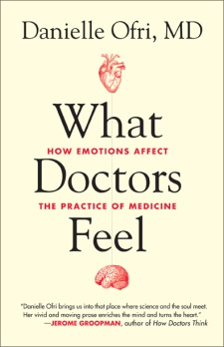
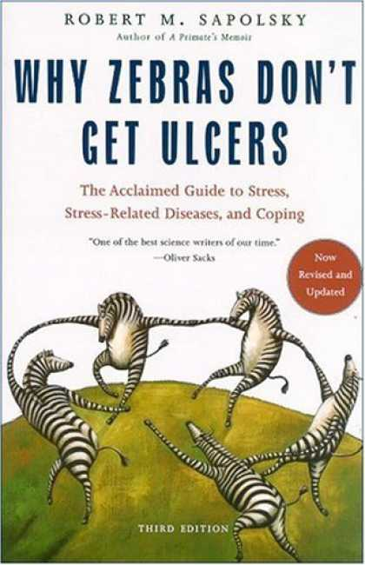
Extra Credit Opportunity #1
  I will bribe you to read 2 chapters about stress from books that I love
  Chapters are posted on my google site –
  https://sites.google.com/site/s17psy89/
  You will choose 2 chapters from the options to read & then
    Write an original summary describing each chapter
    Write 3-5 original reaction points to each chapter
  Due on Bb Sunday 3/10 by 11:59pm
  Worth 1 point!
  I was shocked that … because …
  I had a hard time buying the part about … because…
  I want to know more about … because…
  Knowing … is incredibly useful because…

Slide 8
Thernstrom’s “Pain Chronicles” + Treatments for Stress & Pain
2/25/20

Slide 9
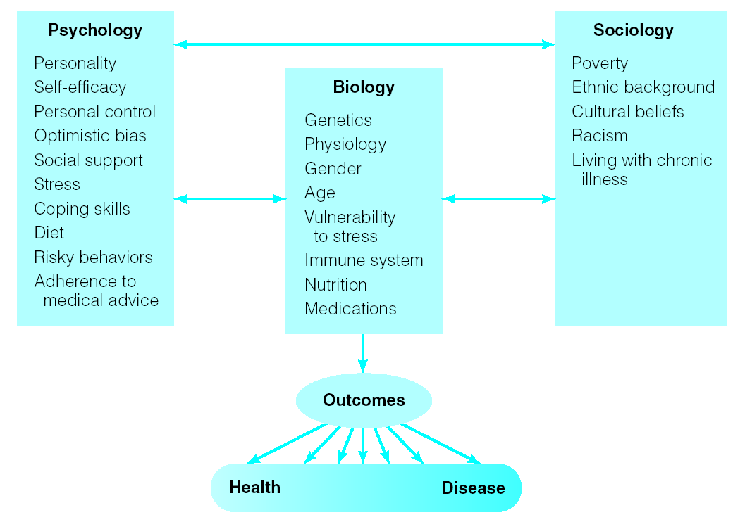
The Biopsychosocial Model
We also used the term “Diathesis-Stress Model” to reflect that the impact of stress/trauma or pain DEPENDS ON predispositions & vulnerability

Slide 10
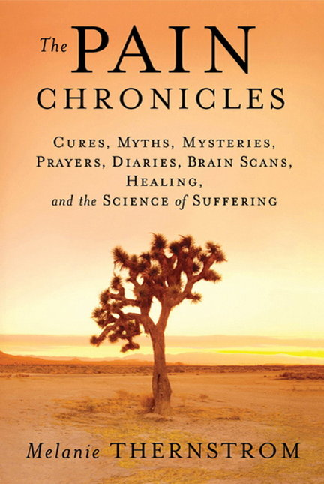
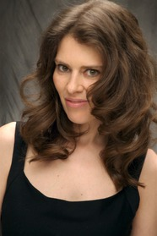
Patients’ narratives (stories, understanding, beliefs) can increase or decrease pain & influence adherence to treatment
Nociception
Pain
Disability
Suffering
Pain Behavior

Slide 11


Integrative vs. Disintegrative Pain
  Culture influences pain perception
    Ex: Thaipusam
      https://www.tripsavvy.com/what-is-thaipusam-1458358
    Ex: cultural ideas about childbirth
Other examples where people’s narratives / explanations for pain affect their experience of pain?

Slide 12
Shelley Taylor’s Theory of Cognitive Adaptation (1983)
People adapt to threatening / traumatic events by
Searching for meaning in the experience / world
Enhancing one’s self-esteem to feel good
Regaining mastery over the event / one’s life

Slide 13
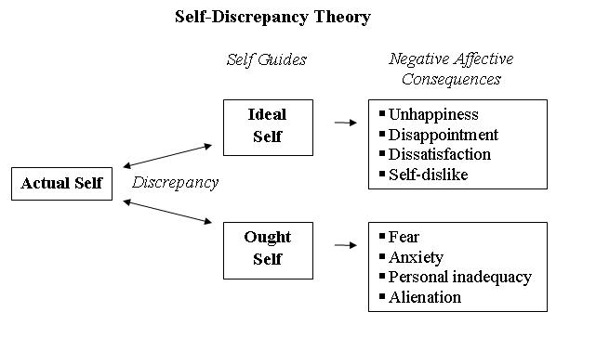
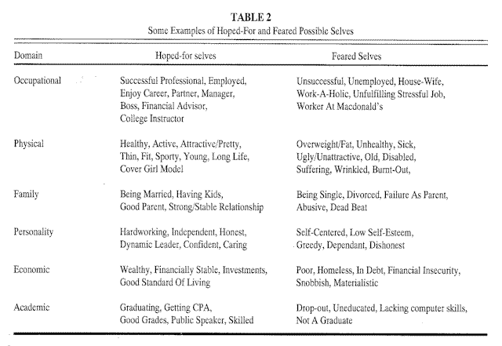
Hoped for
vs.
Feared for Selves

Slide 14
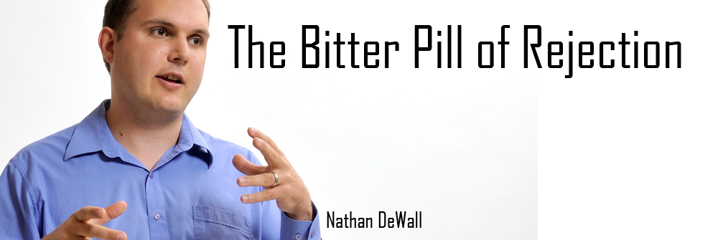
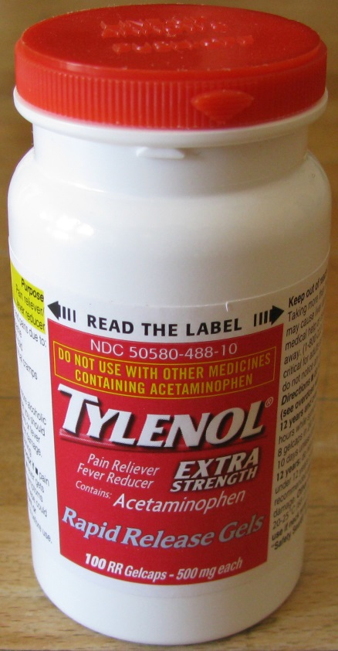
Is social pain truly painful?
  Why do we call it “heart ache?”
  Would taking tylenol help?
  People self-medicate social/emotional pain
Examples of patients refusing treatments that “work the wrong way”

Slide 15
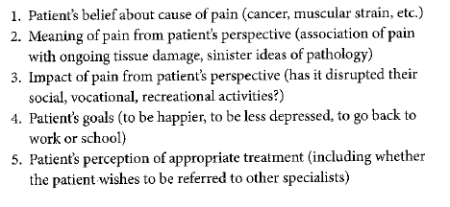
“The Stanford 5”
Dr. Sean Mackey developed this list of 5 issues doctors treating pain patients should be aware of
Note the emphasis on “from patient’s perspective”

Slide 16
Relating Research to Real Life
Who is Dani?
What happened to her?
How did she cope?
What factors from class relate to her situation?
How did her narrative change with Dr. Portnoy vs. Dr. Sarno vs. Clint?
How might the “mind/body problem” and the stigma of mental illness hurt pain patients?

Slide 17
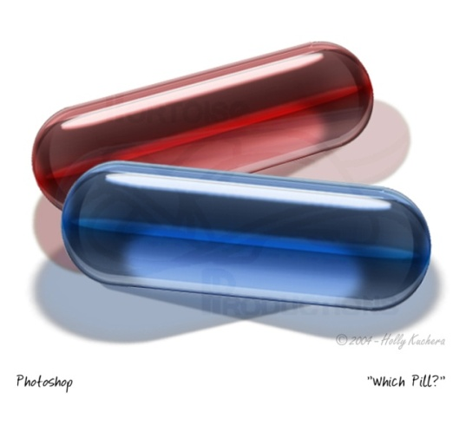
Complications in studying pain
Placebo Effects: (I will please)
  When an inactive substance or treatment leads participants to benefit from it because they believe they are getting an active treatment
    In drug trials, a sugar pill that looks like the test drug is often used
    Experimental surgeries or therapies are more difficult
    Sham surgery for knee problems
    Educational group to compare to support group
    Nina’s treatment for my mother-in-law…
  “Placebo paradox” – deceptive, but effective
Nocebo Effects: When people report
negative side effects from an inactive
treatment
  Hear about these in drug commercials
  Ex: Voodoo curse
Notes:
17

Slide 18
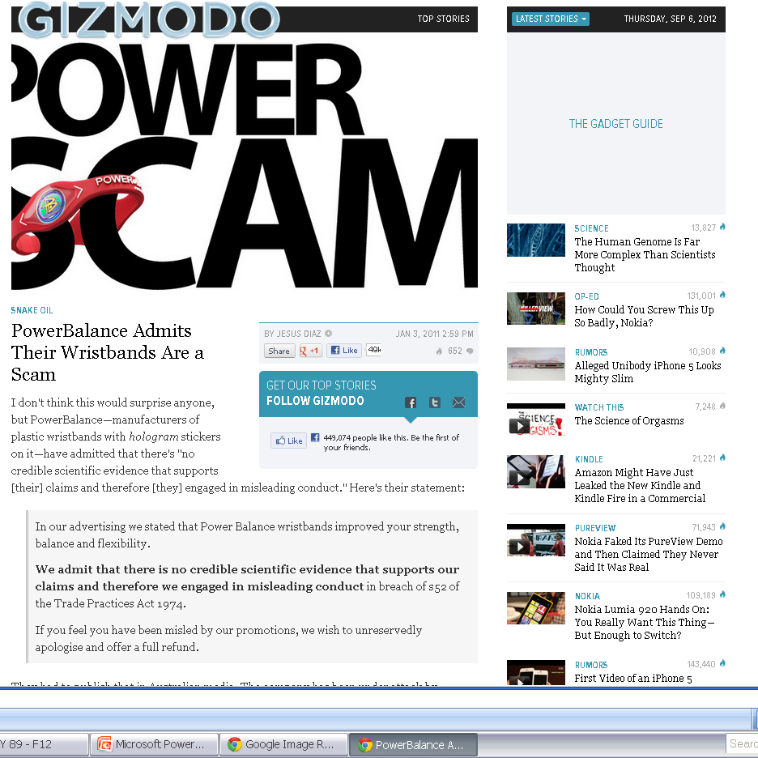

Slide 19
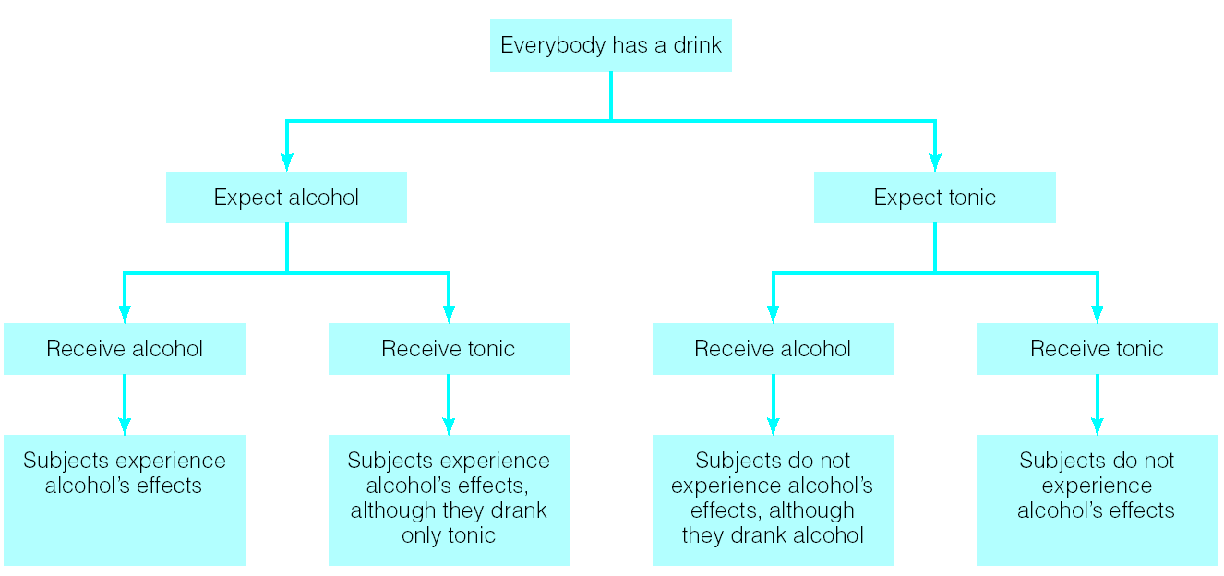
Expectancy Effects?
Ethics???
What if this were a trial of a surgery vs. sham procedure?
Also see examples of this with food

Slide 20
Placebo effects
Based on expectations & learning
  Expectations influence the quality & magnitude of the effect
    Ex: $10 vs. 10cents, injection vs. pill
  Remember classical conditioning?
  Like other learned reactions, placebo effects fade over time
In pain perception, expectations can stimulate or inhibit endorphins & other endogenous pain reduction
Blocking endorphins blocks the placebo effect

Slide 21
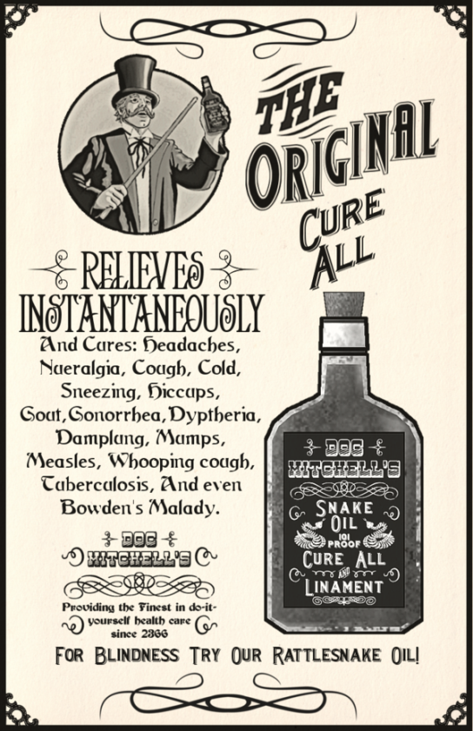
Pain & Belief
If people get genuine pain relief from placebo treatments, should we prescribe them?
Should doctors work harder to persuade, motivate & inspire their patients?

Slide 22
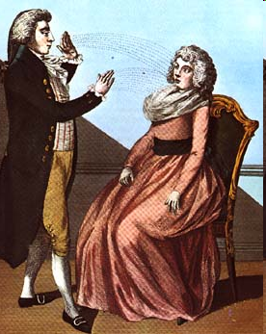

Hypnosis
Originated in 1830s France
Franz Mesmer would perform tricks
and “Mesmerize” people
  Even used as anesthetic by surgeons
  Popularity waned w/ advent of chemical anesthetics
Freud used hypnosis as treatment for mental illness
Has gone in and out of fashion over time
Currently, very controversial

Slide 23
Hypnosis
Some see it as role-playing
Some see it as an altered state of consciousness
  Brain imaging studies support the altered-consciousness view, but there are differences among people (some more suggestible)
Others see it as a trait – a characteristic of some people who respond well to suggestion
Regardless, hypnotherapists believe it can be beneficial
  Patients’ expectations play a big part
  Any benefits may result from the combination of placebo, relaxation, and focus

Slide 24
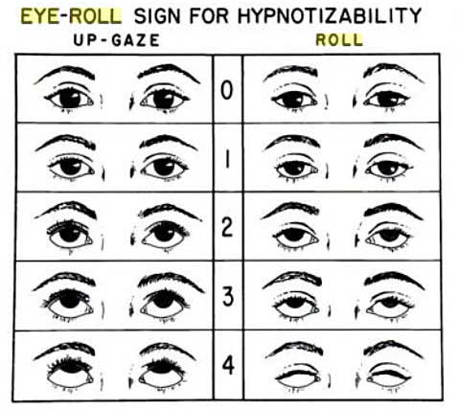
When you hold your head still, face forward, and look up toward your eyebrows & the top of your head, how much white is visible?
This quick & goofy test is associated with susceptibility to hypnotism
People on the 0-1 end are likely to be less hypnotizable than people on the 3-4 end
The more established method is to complete an induction like the Stanford Scale
http://ist-socrates.berkeley.edu/~kihlstrm/PDFfiles/Hypnotizability/SHSSC%20Script.pdf

Slide 25
Medical Treatments for Chronic Pain
Medications (ex: analgesics, opiates)
  Underprescribed & Overprescribed
  Patients may resist taking meds
      Beliefs about toughness/deservedness
      Fear of side effects/addiction
      Try to ration in case things get worse
Surgeries
  Severing nerves to decrease transmission
  Limited benefits
Additional meds to treat related issues
  Anxiety (ex: Joey vs me)
  PTSD
  Depression
Placebo effects can contribute to the effectiveness of all of these treatments

Slide 26
Physical Therapy & Exercise
Exercise improves cardiovascular reactivity, making stress less damaging
Can also be a coping method
Releases endorphins & promotes positive mood states
Prevention → Weak muscles & low flexibility make pain more likely
Aerobic exercise & strength training can reduce pain & disability for sufferers
Stress Benefits
Pain Benefits
Exercise is one of the best tools for preventing stress & pain, and physical therapy is one of the best treatment strategies. Why don’t people do them as much as recommended?

Slide 27
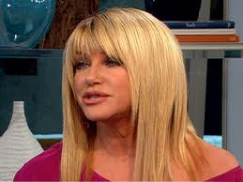
Complementary/Alternative Medicine (CAM)
Limitations:
  Little research on the topic → sparse evidence
  Even when there isn’t scientific evidence, patients may benefit from placebo effects
  Benefits may be limited to shortly after treatment
Few people use CAM as only treatment
Integrative Medicine
  An attempt to combine conventional
  and alternative treatments
Multimodal treatment
  Combining many approaches to treat a patient

Slide 28
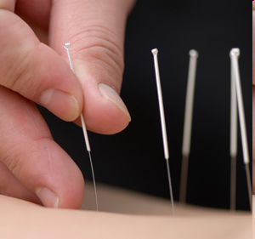
CAM
Mechanisms?
Placebo effects? Benefits of touch? Distraction? Relaxation? Perception of control?
Manipulation Techniques
  Massage ~ 2000 BC
      Benefits mostly to mood → stress reduction
      Some evidence for improved immune function, lower BP
  Acupuncture – ancient Chinese treatment
      Needles inserted into skin & stimulated
      Based on philosophy of balancing “vital energy” or qi
      Some evidence for effectiveness in treating stress / pain, esp. with infertility
  Chiropractic manipulation – 1895
      Believed it could cure & prevent illness
      Mixed evidence – AMA has fought chiropractors and lost

Slide 29
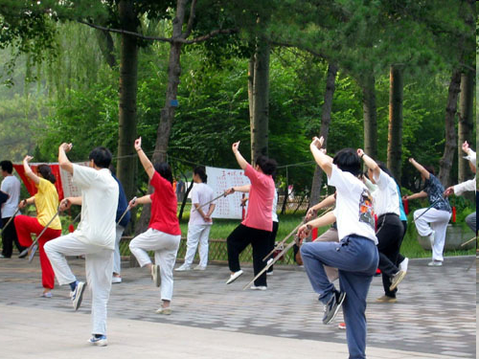
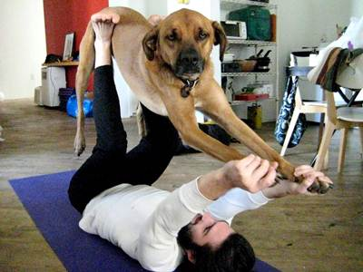
CAM
Movement-based therapies
  Tai chi – series of exercises intended to balance the body’s “vital energy”
    Promotes relaxation through breathing techniques
    Evidence for decreased anxiety, depression
    May boost immune function
    Helps older people maintain balance / flexibility
  Yoga has similar benefits

Slide 30
Coping Strategies for Pain?
Problem-Focused Coping vs.
Emotion-Focused Coping
Approach coping
vs.
Avoidance coping
Self-distraction
Active coping
Denial
Substance use
Use of emotional support
Use of instrumental support
Behavioral disengagement
Venting
Positive reframing
Planning
Humor
Acceptance
Religion
Self-blame
Additional factors:
Post-traumatic growth / benefit finding, perceived control, religion, status, social support, personality

Slide 31
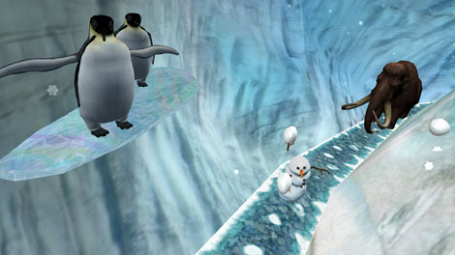
Distraction to reduce stress & pain
Example – “Snow world” helps burn patients
https://www.youtube.com/watch?v=P3QiRMZi6JY
Emotional
Physiological
Why don’t clinics have art / posters / screens where patients look when they’re having potentially painful procedures?
Sensory

Slide 32
Does Humor Help?
Mechanisms?
Promotes Positive Affect
Provides Distraction
https://www.youtube.com/watch?v=tqtIyftTiWI

Slide 33


Emotional Expression
Suppressing emotions can be damaging
  Ex: stigmatized identities
Expressing emotions can be beneficial
  Ex: Pennebaker’s writing studies → write for ~20 min / 3-4 days
    We develop a narrative about our traumas and pain, literally
    Putting emo / traumatic experience into writing helps add structure to chaotic, potentially obsessive thoughts
  Of course, expressing hostility can make stress worse

Slide 34


Personality & Health
Personality is defined by it’s stability
Can you change your personality?
  Ex: pessimism, hostility
“If you want to be somebody else, change your mind”
-Sister Hazel song from ‘00
But how? Through coping, support & therapy

Slide 35
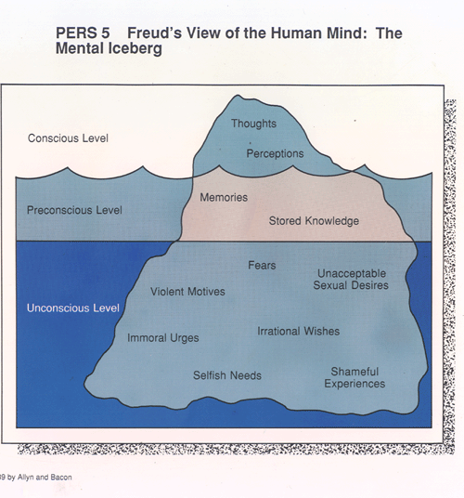
Multiple Psych Perspectives (preview for Thursday)
1st Wave – Psychoanalytic
  Need to discover & address the deep,
  root causes of your problems
2nd Wave – Cognitive Behavioral Therapy
  Your thoughts & behavior are problematic, so let’s practice changing them
  Use relaxation techniques to gain control
3rd Wave – Acceptance Therapy
  We all have negative thoughts. The problem is paying too much attention to them
  Use mindfulness & other techniques to control attention
You don’t have to know these distinctions for the exam – I’m trying to give context to these different techniques

Slide 36
Next class
More treatments for stress & pain – including demonstrations!
Opportunity to ask questions you have
Review for exam 1

